Slide 1

Modern Software Design Methods for Concurrent and Real-Time Systems
By Hassan Gomaa
Presented by James Roberts
2-12-2007

Slide 2
Introduction
Real-Time systems are becoming more prevalent
Concurrent processing is a part of real-time systems

Slide 3
Concurrent Processing Concepts
Concurrent Tasks
Mutual Exclusion
Synchronization of Tasks
Message Communication

Slide 4
Concurrent Tasks
A concurrent task (process) is the execution of a sequential component of a concurrent program.
It is having multiple asynchronous tasks running at different speeds.
Concurrent tasks need to coordinate
Notes:
They coordinate using mutual exclusion or task synchronization

Slide 5
Mutual Exclusion
Required when only one task may have access to a resource at a given time
Critical section
Example of robots
Example of kitchen
Notes:
The part of a program that a task executes when it has exclusive access to a resource is referred to as its critical section or critical region.

Slide 6
Mutual Exclusion
Solving the mutual exclusion problem
Semaphores
  P(s) – Potential wait
  V(s) – Leaving critical section
  Perform operations outside critical section
  P(Collision_Zone_Semaphore)
  Perform critical section operations
  V(Collision_Zone_Semaphore)
  Perform more operations outside critical section
Notes:
Semaphores are incremented/decremented

Slide 7
Synchronization of Tasks
Producer/Consumer Signalling
Signal(event)
Wait(event)

Slide 8
Synchronization Psuedocode
Robot A 1. Pick up part 2. Move part to workplace 3. Release part 4. Move to safe position 5. Signal(part_ready) 6-9. Wait(part_completed) 10. Pick up part 11. Remove from workplace | Robot B 1-5. Wait(part_ready) 6. Move to workplace 7. Drill four holes 8. Move to safe position 9. Signal(part_completed)

Slide 9
Message Communication
Used when data needs to be passed between two tasks
Asynchronous message communication
Synchronous message communication
  With reply
  Without reply
Notes:
Asynchronous communication is when the producer sends a message to the producer and continues to process. There is a queue that the messages go into and the consumer continues to grab the messages off the queue in the order they come in. The producer has no idea what message the consumer is currently processing.
Synchronous message communication requires that the producer get some kind of response back from the consumer before continuing on.
In “with reply”, the producer waits for some reply back from the consumer before continuing processing.
In “without reply”, the producer waits for the consumer to acknowledge that it has accepted the message before continuing.

Slide 10
Example Message Communication
1 2 3 4 5 | Vision System: Wait(car_arrived) Take picture of car Identify car Determine location and orientation of car Send message to robot (car model, offset) | 1-5 6 7 8 9 | Robot Task: Wait for message from vision system Read message (car model, offset) Select welding program for car model Execute welding program using car offset Signal(Move_car)
Notes:
It looks like this message communication is asynchronous.

Slide 11
Run-Time Support
Provided by
  Kernel of an operating system
    Services provide concurrent processing functionality
    Microkernel
  Run-time support system
  Threads package
    Managing threads within heavyweight processes

Slide 12
Language Support
No support from sequential programming languages like:
  C, C++, Pascal, Fortran
  Must use a kernel or threads package
Concurrent programming languages do support
  Ada, Java
  Constructs for task communication and synchronization
Notes:
The languages runtime system handles task scheduling and provides the services and underlying mechanisms to support intertask communication and synchronization.

Slide 13
Real-Time Operating Systems
Requirements
  Support multitasking
  Support priority preemption scheduling
  Provide synchronization and communication
  Provide memory-locking
  Provide a mechanism for priority inheritance
  Have a predictable behavior

Slide 14
Design Methods
Several design methods have been developed.
  MASCOT
  RTSAD (Real-Time Structured Analysis and Design
  DARTS (Design Approach for Real-Time Systems)
  JSD (Jackson System Development)
  CODARTS (Concurrent Design Approach for Real-Time Systems)
  Octopus
  ROOM (Real-Time Object-Oriented Modeling)

Slide 15
A Modern Design Method
COMET (Concurrent Object Modeling and Architectural Design Method)
Integrates object-oriented and concurrent processing concepts
Uses the UML (Unified Modeling Language) notation
Describes decision made on how to use the UML notation

Slide 16
The COMET Method
Used to develop concurrent applications
Highly iterative software life-cycle
  Requirements modeling
  Analysis modeling
  Design modeling
Notes:
In the requirements modeling phase, a use case model is developed
In the analysis modeling phase, static and dynamic models of the system are developed.
In the design modeling phase, an architectural design model is developed.

Slide 17
Requirements Modeling
The UML use case model is developed
Actors can be
  Human users
  External systems
  I/O Devices
  Timers

Slide 18
Analysis Modeling
Static Modeling
Object Structuring
Dynamic Modeling

Slide 19
Static Modeling
System context
  The interface between the system and the external environment
UML does not support system context diagram
  Use a static model or
  Collaboration model

Slide 20
Object Structuring
Categorize objects in order to group similar objects.
UML stereotypes are used
Stereotype – A subclass of an existing modeling element
Can be
  <<entity>> class
  <<interface>> class
  <<control>> class
  <<application logic>> class
Notes:
Entity class – a persistent class that stores data
Interface class – interfaces to the external environment
Control class – provides the overall coordination for the objects that participate in a use case
Application Logic class – Encapsulates algorithms separately from the data being manipulated

Slide 21
Dynamic Modeling
State-dependent dynamic analysis
State chart is used
Collaboration diagram is used
These two diagrams are used in conjuction

Slide 22
Design Modeling
Transition From Analysis to Design
Software Architecture Design
Concurrent Collaboration Diagrams
Architectural Design
Task Structuring
Detailed Software Design

Slide 23
Transition from Analysis to Design
Collaboration diagram is developed for each use case
Consolidated collaboration diagram
  A synthesis of all the collaboration diagrams developed to support the use cases
  Can be quite large
  May call for subsystem collaboration diagrams to be developed
Analogous to robustness analysis

Slide 24
Software Architecture Design
Broken down into subsystems
Interfaces between subsystems are defined
The goal – To have objects with strong coupling in the same subsystem, weak coupling in differing systems.
Subsystem – A composite object

Slide 25
Concurrent Collaboration Diagrams
Active objects are identified
  Have own threads of control
  Thick black lines
Passive objects are identified
  Activated by other objects
  Thin black lines

Slide 26
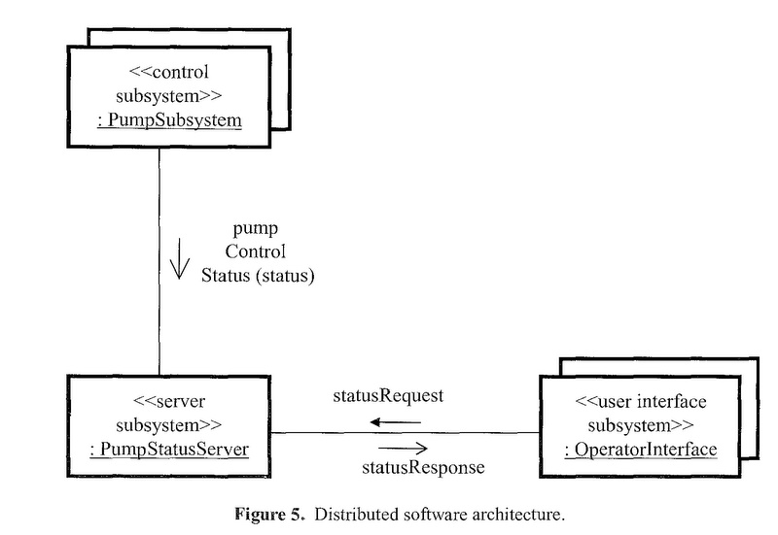
Architectural Design
Communications between subsystems defined.

Slide 27
Task Structuring
Each subsystem is structured into concurrent tasks
Task interfaces defined
Stereotypes are used
  <<I/O device interface>>
    <<Asynchronous I/O device interface>>
    <<Periodic I/O device interface>>
    <<Passive I/O device interface>>
    <<Resource monitor>>
  <<External input device>>
  Etc…

Slide 28
Detailed Software Design
Composite task internals designed
Detailed task synchronization issues
Connector classes designed
Task’s internal event sequencing logic is defined

Slide 29
Performance Analysis
Performance analysis in real-time systems is very important
Use realtime scheduling theory
Event sequence analysis

Slide 30
Conclusions
Real-Time Software Design is not very different from normal software design
There a few different issues to watch out for and design for
This method is particularly nice since it uses the UML which most already have an idea of how to use

Slide 31
Questions???

